Slide 1
Empowering Educators: Strategies for Fostering Resilience and Well-being in Schools
Dr Scott I-Patrick CPsychol
Senior Educational Psychologist

Slide 2
Session Aims
Understand Positive Psychology
Learn about the PERMA Model
Explore Innate Predispositions for Joy
Participate in an Interactive Activity
Introduction to Appreciative Inquiry
Further Reading and Resources

Slide 3
Intended Outcomes
Practical tools for enhancing well-being
Strategies for creating a positive school environment

Slide 4
Encapsulating Well-being
Well-being could be likened to the foundation of a school building. Just as a strong, stable foundation is essential for the safety and function of a school, well-being is the underpinning that supports not only the academic but also the emotional and psychological development of students and staff. When the foundation is robust, the building can weather storms and stand tall; similarly, a focus on well-being allows everyone within the school community to thrive, even in challenging times.

Slide 5

Introduction: The Importance of Well-being
The Juggling Act: Responsibilities and Stresses
Impact on Teachers and Students
Why We Can't Ignore Well-being

Slide 6
What is Positive Psychology?
Beyond the Medical Model
The Study of Human Flourishing
The Science of Well-being

Slide 7
The PERMA Model: An Introduction
P: Positive Emotion
E: Engagement
R: Relationships
M: Meaning
A: Accomplishments

Slide 8
Positive Emotion: The Fuel for Well-being
What Are Positive Emotions?
Tomkins' Theory of Affect Script
Innate Drive for Joy and Interest

Slide 9
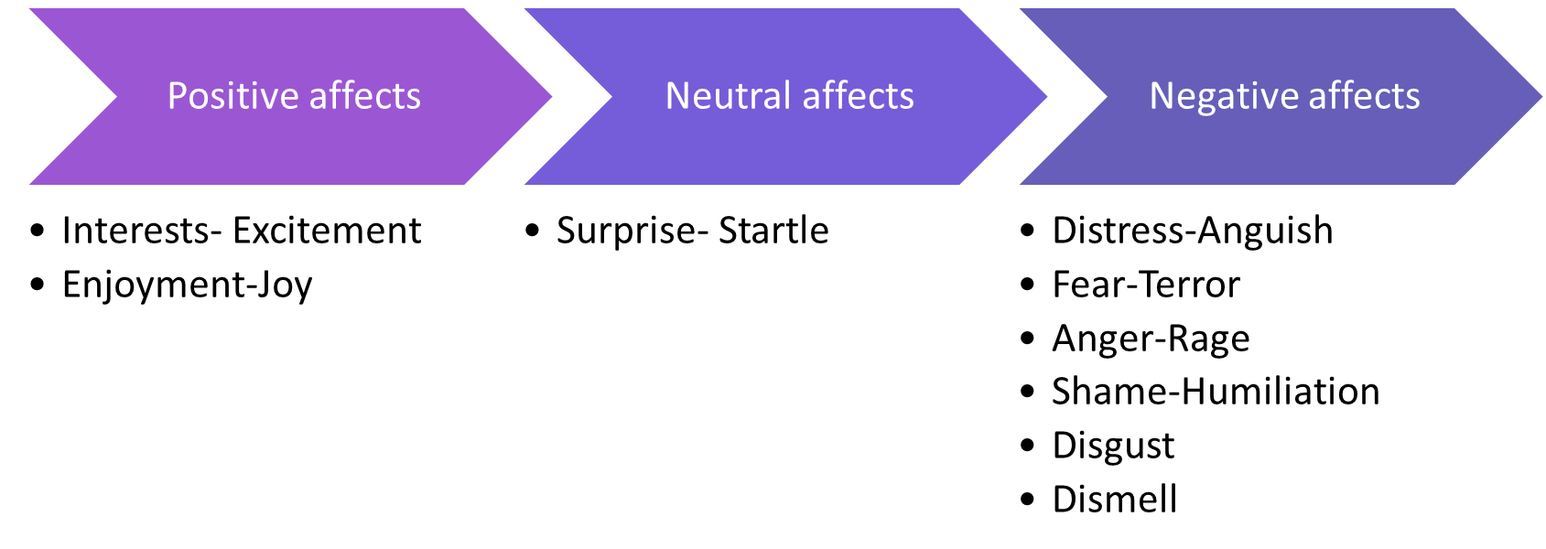
Theory of Affect Script

Slide 10
Maximizing Positive Affect, Minimizing Negative Affects
The central executive concept states that we are innately programmed to:
maximize positive affect,
minimize negative affects, and
minimize the inhibition of affect.
Our ability to function effectively is dependent on these factors being in place.
Understanding the impact of context on behaviour and can help promote positive affect and minimize negative affects.

Slide 11
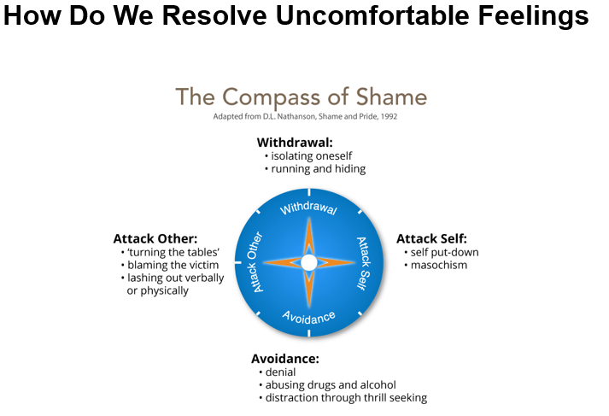
Compass of Shame Scripts

Slide 12
Engagement
What is Engagement?
The concept of "Flow" by Mihaly Csikszentmihalyi.
Importance of Engagement in work and life.
Strategies for increasing Engagement.

Slide 13

Relationships
What are Relationships in the context of PERMA?
Why Relationships are important for well-being.
The role of social support in mental health.
Practical ways to cultivate meaningful relationships.

Slide 14
Meaning
What does "Meaning" mean in the context of PERMA?
Why is Meaning important for well-being?
The role of purpose in education.
Practical ways to find meaning in your work.

Slide 15
Accomplishments
What does "Accomplishments" mean in the PERMA model?
The importance of celebrating wins, both big and small.
How accomplishments tie into school goals.
Setting and achieving realistic targets.

Slide 16
Interactive PERMA Assessment Activity
Introduction to AuthenticHappiness.org
Instructions for completing a WORKPLACE Perma Profile

Slide 17
Appreciative Inquiry: Making Schools Better
What is Appreciative Inquiry?
Why it’s Good for Schools
Practical Exercise: The 4-D Cycle

Slide 18
Operationalising Appreciative Inquiry in Schools: The 4-D Cycle
Discover
Dream
Design
Deliver

Slide 19
Hands-On Activity: Applying Appreciative Inquiry in Schools – 15 mins
let's break into small groups of 4.
In your groups, think about something good that recently happened at your school.
Chat about why it was good—this is your 'Discover' stage.
Then, let your imagination run wild in the 'Dream' stage.
What could make this even better?
Next, come up with a simple plan in the 'Design' stage.
And lastly, talk about how to make it real in the 'Deliver' stage.

Slide 20
Taking Well-being Back to Your School
How to Introduce PERMA in School
Fostering a Positive School Culture
Resources and Next Steps

Slide 21
Craft Your School's Well-Being Action Plan: Group Activity
Elements to consider: Positive Emotions, Engagement, Relationships, Meaning, Accomplishments
Sharing and Feedback

Slide 22
Summary and Takeaways
Importance of Personal Well-Being for Leadership
PERMA: A Framework for Well-Being
Appreciative Inquiry: Focus on Strengths
Crafting Your School's Well-Being Action Plan

Slide 23
Further Reading and Resources
Flourish: A Visionary New Understanding of Happiness and Well-being - by Martin Seligman.
Drive: The Surprising Truth About What Motivates Us - by Daniel H. Pink.
Appreciative Inquiry: A Positive Revolution in Change - by David L. Cooperrider and Diana Whitney.
The Power of Positive Leadership - by Jon Gordon.
Learned Optimism: How to Change Your Mind and Your Life" by Martin Seligman
AuthenticHappiness.org - Free well-being assessments.
Link to Thesis: What Can Children and Young People Tell Us About School Sanctions and Social Relationships? An Exploration of Exclusionary and Restorative Justice Practices
https://www.researchgate.net/profile/Scott-Ighavongbe-Patrick/achievement/64dc92b66abb92713d17fd84 via @researchgate
https://www.researchgate.net/profile/Scott-Ighavongbe-Patrick/achievement/64dc92b66abb92713d17fd84

Slide 24

Thanks for Listening and engaging

